Slide 1
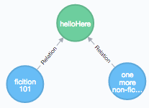
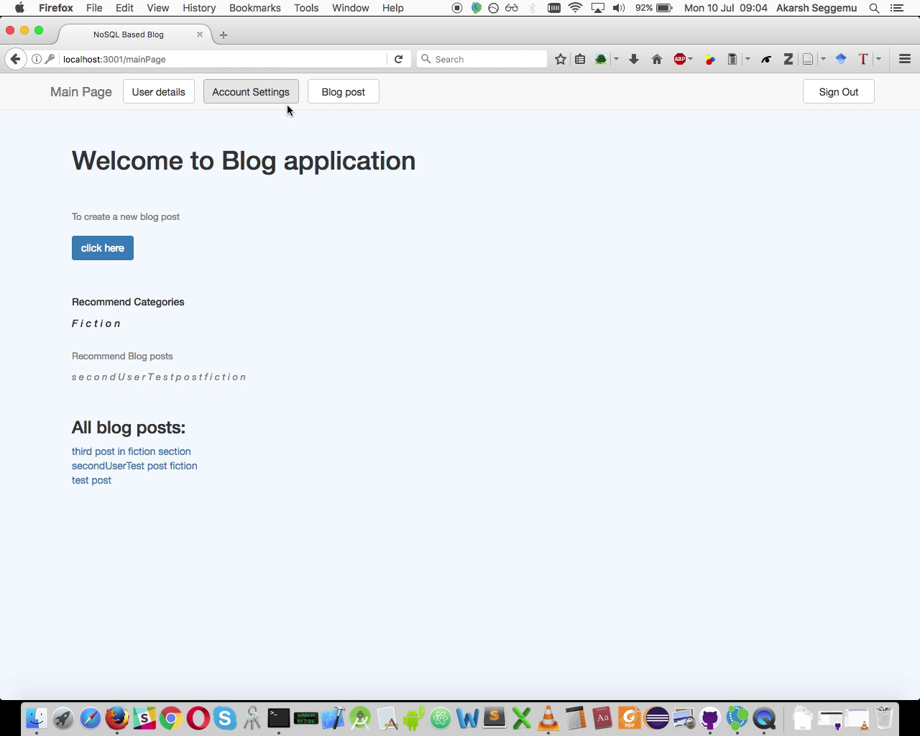
BLOG
NOSQL Databases (0423 L 777), SoSe 17
10.07.2017, Berlin
Akarsh Seggemu
Budankailu Sameer Kumar Subudhi Sonali Bhatnagar

Slide 2
Agenda
1.
Plan
2.
Databases
3.
Live demo

Slide 3
Plan
Task | Week no.
Kick-off meeting | Week 1
Literature research | Week 1, 2
Initial implementation | Week 2
Pitch presentation | Week 2
Reviews of initial implementation | Week 3
Final Implementation | Week 4,5
Final presentation | Week 6

Slide 4
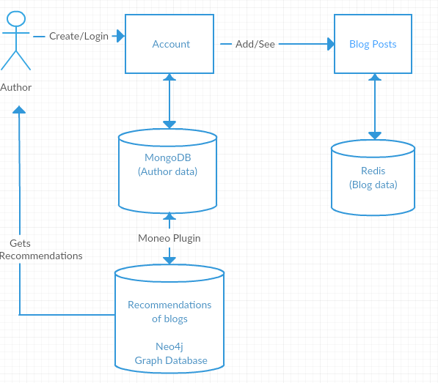
Application Architecture

Slide 5
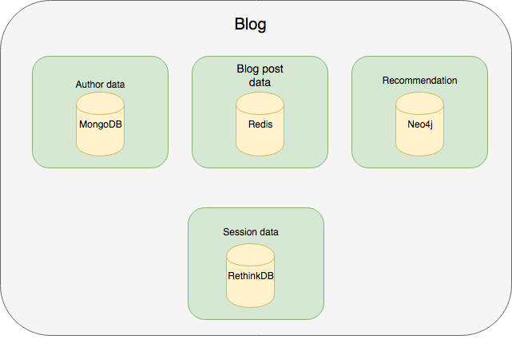
Databases: Architecture
MongoDB

Slide 6

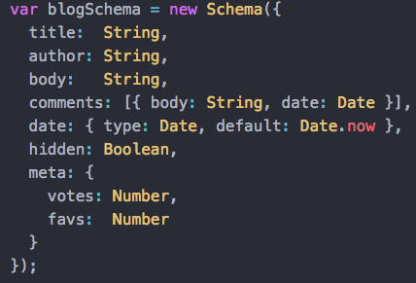

NOSQL Databses: MongoDB
Author data
ODM – Object Data Modelling

Slide 7

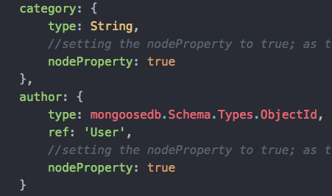
NOSQL Databses: moneo (plugin/middleware)
+ moneo =
Schema
Add nodeProperty: true
Add Schema.plugin(moneo)
Data Model

Slide 8
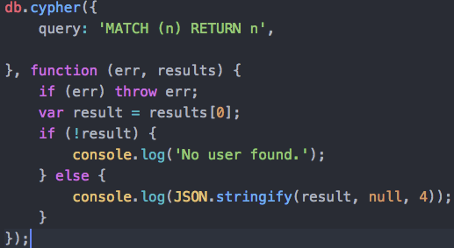
NOSQL Databses: Neo4j
Recommendation
Category
Blog posts
Node-Neo4j
Node.js driver for Neo4j via it’s REST API
Author
Fiction post
Non-fiction post

Slide 9

NOSQL Databses: Redis
Stores Blog Data: Blog Title,
Category,
Blog Content
Data is key-value pair with Key as Id and Value as Blog Data

Slide 10
Redis : Problems Encountered
Data can only be stored as key value pairs
(Blog Title, Content)
What if we wish to store more fields like Category, Username?
Solution : Store data in an array

Slide 11
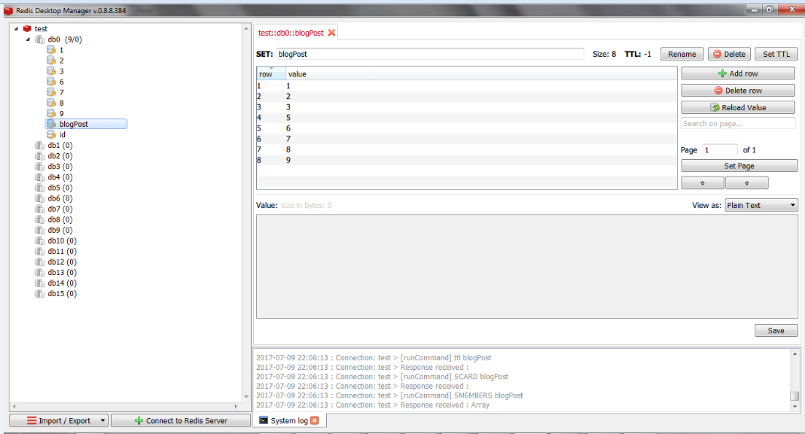
Redis Storage

Slide 12
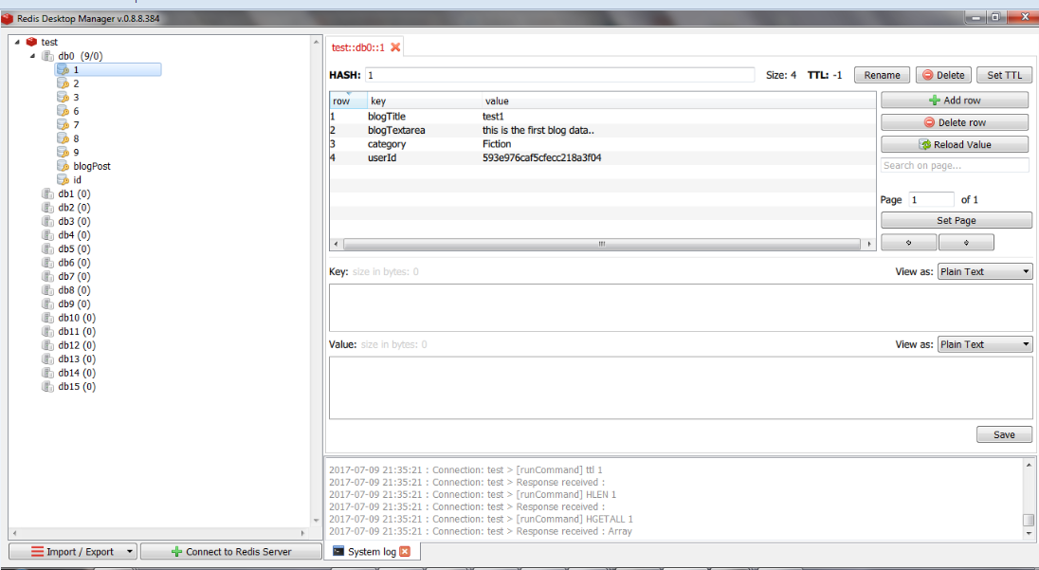
Redis Storage

Slide 13
Advantages of Using Redis
Fast retrieval of blog data as compared to Mongo
Supporting wide variety of data types
Future advancements in application can add more complex data types like list, sets etc

Slide 14

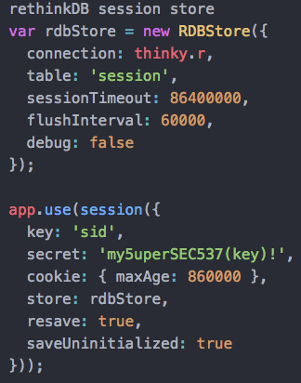

NOSQL Databses: RethinkDB
Session storage
Thinky
ORM – Object Relational mapping
express-session-rethinkdb
RethinkDB session store for Express 4.x

Slide 15
Live demo

Slide 16
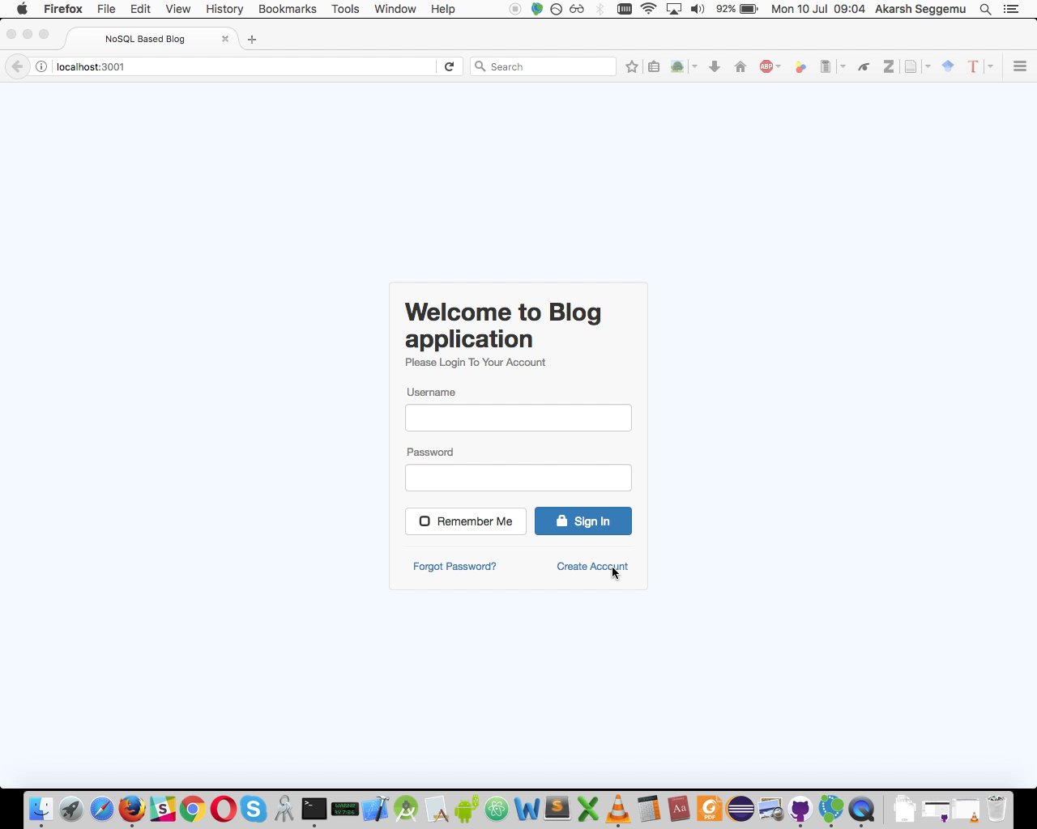

Slide 17
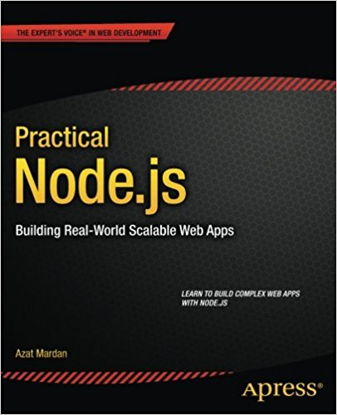
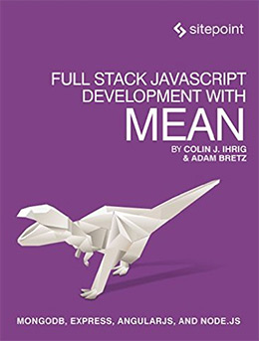
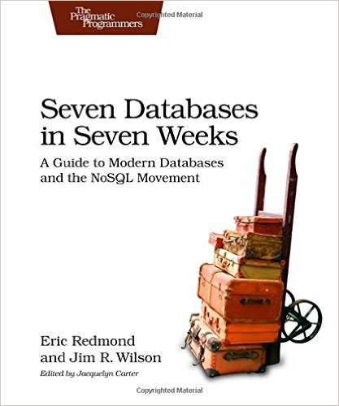

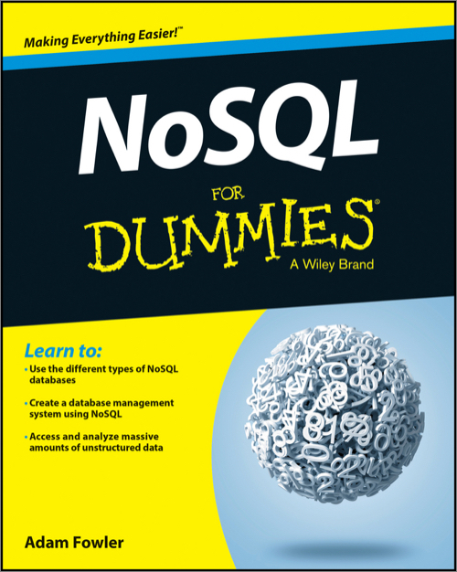
Literature
TUB - Library ST 250 J35 316
HUB - Library
ST 250 J35 B845
TUB – Library
ST 270 243
HTW - Library ST 270 S124
HUB – Library
ST 270 F785

Slide 18
Q & A ?
Thank you | Danke schön |
ధన్యవాదాలు

